Slide 1

Movie Recommendation Systems
By: Kiran Teja Sarvamthota

Slide 2

Problem
Netflix has thousands of movies
Users on the other hand has limited time and patience.
Users don’t have knowledge on the movies.

Slide 3
Recommendation
HELP USERS NAVIGATE THE MAZE OF ONLINE STORES
FIND WHAT THEY ARE LOOKING FOR
FIND THINGS THEY MIGHT LIKE, BUT DIDN’T KNOW OF
RECOMMENDATIONS HELP ONLINE STORES SOLVE THE PROBLEM OF DISCOVERY

Slide 4
RECOMMENDATION ENGINES NORMALLY USE ONE OR MORE OF THESE TECHNIQUES
CONTENT-BASED FILTERING
COLLABORATIVE FILTERING
ASSOCIATION RULES

Slide 5
Collaborative Filtering
UNLIKE CONTENT-BASED FILTERING, COLLABORATIVE FILTERING DOESN’T REQUIRE ANY PRODUCT DESCRIPTION DATA AT ALL!
THE BASIC PREMISE IS THAT : IF 2 USERS HAVE THE SAME OPINION ABOUT A BUNCH OF PRODUCTS, THEY ARE LIKELY TO HAVE THE SAME OPINION ABOUT OTHER PRODUCTS TOO.
THE ALGORITHM NORMALLY PREDICTS USERS’ RATINGS FOR PRODUCTS THEY HAVEN’T YET RATED

Slide 6
DIFFERENT ALGORITHMS TO PERFORM COLLABORATIVE FILTERING
Nearest Neighbour Based Methods
Latent factor based methods

Slide 7
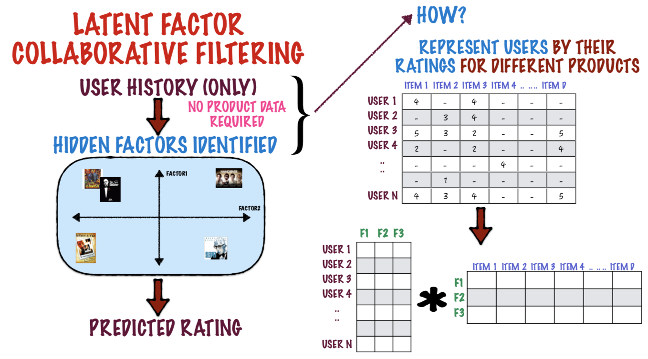
Latent factor based methods

Slide 8
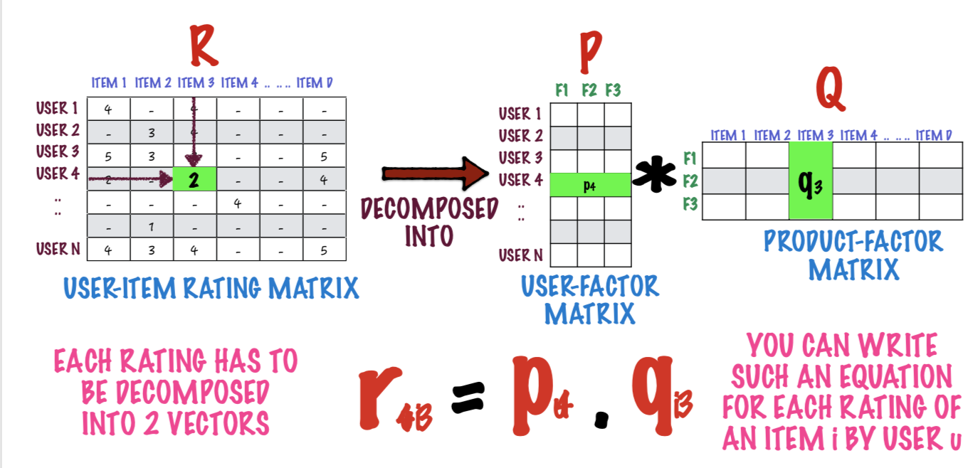
Matrix Factorization
IS TO DECOMPOSE EACH USER RATING INTO A USER-FACTOR VECTOR AND A PRODUCT-FACTOR VECTOR

Slide 9

Normalization
Here I’ve normalized the data as there are some users who gives ratings generously i.e. (if they like the movie they would rate the movie as 5 if they don’t like the movie they would rate 3). On the other hand there could be some users who could rate rate 3 if they like the movie and 1 if they don’t like the movie. By keeping all this into consideration to built a more accurate recommendation model, I’ve normalized the ratings for each user by using the below formula.

Slide 10
Overview of data
Movie lens data set with movies and ratings csv files.
Total number of Users: 610
Total number of movies:9724

Slide 11
Alternating Least Squares
FIND THE SET OF FACTOR VECTORS pu (FOR EACH USER u) AND qi (FOR EACH ITEM i) WHICH MINIMIZE THE ERROR ON THE TRAINING SET.
Matrix factorization is done alternatively i.e. by fixing pu, qi and Repeat until pu and qi converge.

Slide 12
Implementation
Read the ratings file to an RDD and convert it to matrix format.
Normalize the ratings data
Generate two matrices with Usermatrix --U*F and Movie matrix--M*F (U = no of users, M = no of movies , F = 25(Hidden latent features )
Fix matrices using ALS
Calculate RMSE :
Steps 3 and 4 are repeated for 5,10,20 iterations. The final Recommendation matrix is used for predictions.

Slide 13
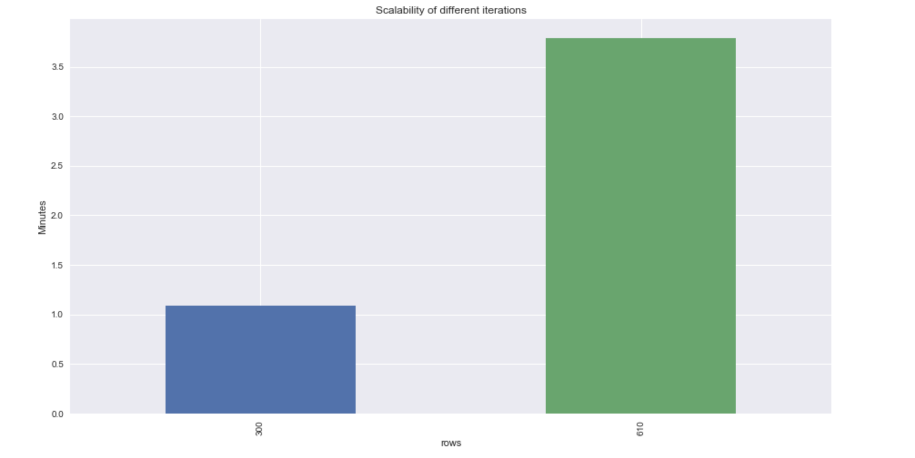
Scalability for different data

Slide 14
Conclusion:
As part of this project I’ve implemented Movie Recommendation systems using collaborative filtering. I’ve solved the problem using matrix factorization method implemented Alternating least squares algorithm to achieve high performance in calculations in distributed environment (Apache Spark).By doing Normalization the RMSE error was reduced by 76 % from (0.3724 to 0.0817) also the running time is reduced. I’ve also scaled the model for different data. The Results I’ve observed is satisfactory and believe there is a lot of scope of improving the prediction model to bring accurate results.

Slide 15
Lessons Learnt
How to make partitions wisely
How to run in Apache Spark environment
How to work on RDD’s and normalize the data.

